Slide 1
Intermediate
Deterministic Models
Day 1

Slide 2
Plan for Today
Course Information & Course Documents
Attention to Detail in ORDA
Introduction to PuLP – a linear programming library for Python
Python constructs used in PuLP (time permitting today)
  list comprehensions
  dictionary comprehensions

Slide 3
Course Information and Course Documents
See course documents:
  course description
  syllabus
  homework format guide
  conda environment
See idm_course GitHub repository
  Reminder:
  **⚠️ Do not edit files in your local copy of this repository.**
  **Copy anything you want to work on into your own workspace.**
  Or use the student_work folder in the repo, Git will ignore that.

Slide 4
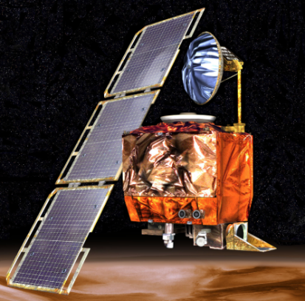

Attention to Detail
NASA Mars Climate Orbiter, 1998
  $655-million robotic space probe
  Burned up in Mars' upper atmosphere due to entering at wrong angle
  Cause: use of wrong units (pound–seconds instead of newton–seconds) in software that ran thrusters
Mariner 1 Spacecraft, 1962
  Veered off course minutes after launch
  Potential for crash in North Atlantic shipping lanes or inhabited area
  Cause: a missing hyphen in a data-editing computer program resulting in incorrect guidance signals
Source: http://www.vitalstatistics.info/uploads/mars%20climate%20orbiter.jpg
Source: https://www.edn.com/wp-content/uploads/media-1193429-mariner-1.jpg

Slide 5
Attention to Detail (cont.)
The Patriot Missile Failure, 1991
  Gulf War US Patriot Missile battery in Saudi Arabia
  Failed to track and intercept incoming Iraqi Scud missile
  28 soldiers killed, 100 others injured
  Cause: inaccurate calculation of time since computer boot-up
    Truncation of a repeating decimal expansion led to a very small error that grew in time
    Resulted in 0.34 second discrepancy, equivalent to over half a kilometer of Scud travel distance
  Read more here: http://www-users.math.umn.edu/~arnold//disasters/patriot.html

Slide 6
For more on these examples and others:
https://www.scientificamerican.com/article/pogue-5-most-embarrassing-software-bugs-in-history/
https://en.wikipedia.org/wiki/Pentium_FDIV_bug
https://www.edn.com/mariner-1-destroyed-due-to-code-error-july-22-1962/
Six Tiny Scientific Mistakes That Created Huge Disasters | World Science Festival
The top 10 IT disasters of all time | ZDNet
11 of the most costly software errors in history [2019 update] · Raygun Blog
Great miscalculations: The French railway error and 10 others - BBC News

Slide 7
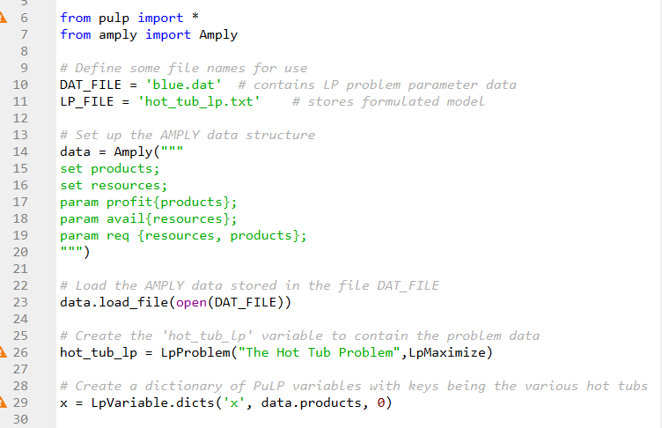
Python & PuLP

Slide 8
Python in Optimization Modeling
Python “lets you work quickly and integrate systems more effectively”
  “integrate systems” – we will be integrating sets of data with optimization models and solvers to produce solutions
(src: python.org)
Python
Data
Data
Structures
Optimization Models
(PuLP & others)
Solvers
(COIN-OR & others)
Solutions

Slide 9

PuLP: a library for expressing mathematical programs (LPs, IPs, MIPs) in Python
Why use PuLP?
Flexibility in modeling thanks to Python setting
  Python data structures and flow control
    lists, dictionaries, etc.
    not limited to what can be expressed in an Excel spreadsheet
  Extensive set of Python libraries capable of
    reading in data
    fetch information from the Internet
    numerical procedures
    creating GUIs
    and much, much more …
(based on Mitchell (2009) and Mitchell (2011))

Slide 10
Why use PuLP? (cont.)
Model size only limited by solution time on our machine
Ease of installation (should be)
Non-restrictive licensing
  Free
  Can be used in commercial applications with no disclosure requirement
Clear syntax
Interoperability with many solvers, such as COIN-OR
  useful for comparisons; can easily step up to faster pay solvers later
Extensive documentation online

Slide 11
PuLP: bottom line
using PuLP we can solve large problems, maintaining confidentiality, for free
may come in handy in your Capstone and beyond
Note: it is provided “as is”, no warranty
** Read PuLP reference docs available in References folder in GitHub repo: **
  2009 Mitchell, Stuart - Intro to pulp for Python Programmers
  2011 Mitchell, Stuart - PuLP A Linear Programming Toolkit for Python
  PuLP solver info.docx
  and others

Slide 12
We will start by building a simple LP in PuLP
Problem Statement:
Blue Ridge Hot Tubs produces two types of hot tubs: Aqua-Spas & Hydro-Luxes.
Problem Data:
Aqua-Spa Hydro-Lux Available
Pumps 1 1 200
Labor 9 hours 6 hours 1566 hours
Tubing 12 feet 16 feet 2880 feet
Unit Profit $350 $300
Formulation
X₁=number of Aqua-Spas to produce X₂=number of Hydro-Luxes to produce
MAX: 350X₁ + 300X₂
S.T.: 1X₁ + 1X₂ <= 200
9X₁ + 6X₂ <= 1566
12X₁ + 16X₂ <= 2880
X₁ >= 0
X₂ >= 0
Let’s implement this in Python/PuLP!
Completed version will be in LEC/lec01 folder in course GitHub repo
after class, called hot_tub_basic.py

Slide 13
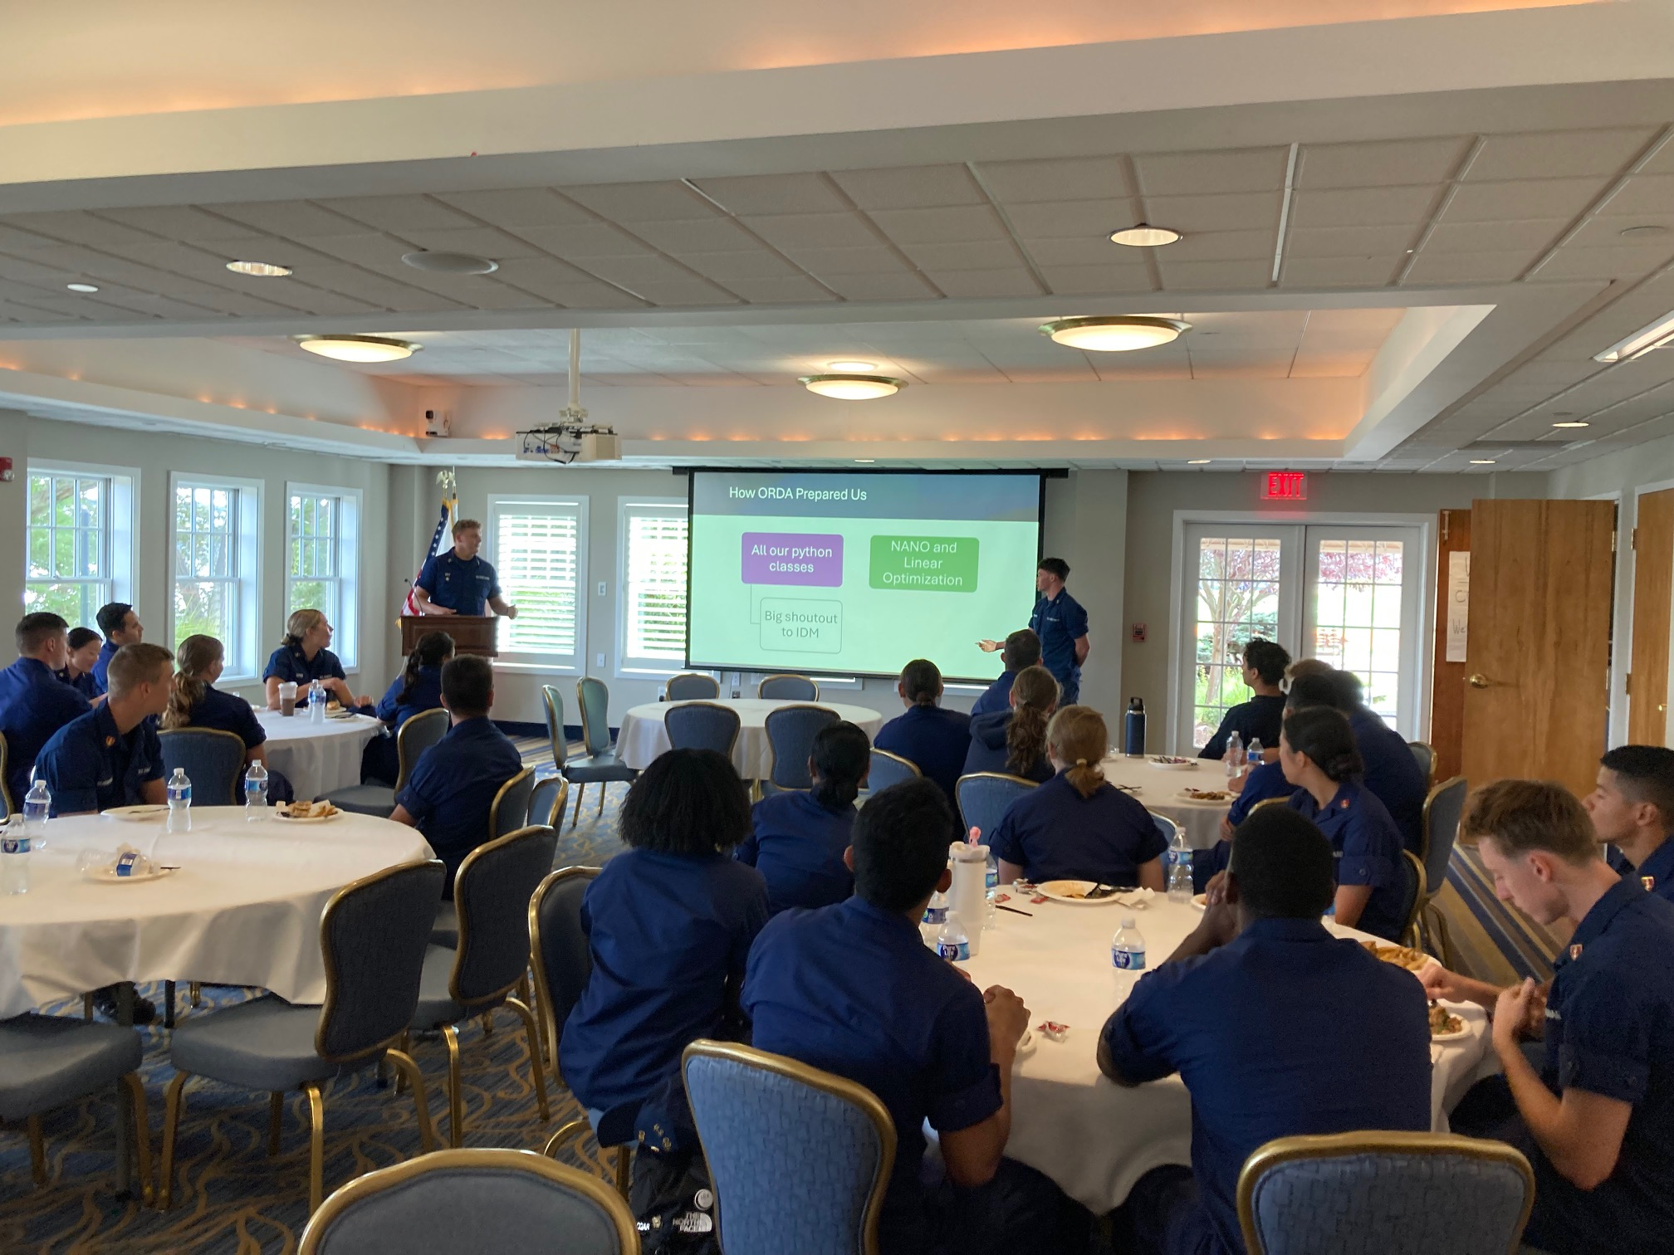
Fall 2025 ORDA internship luncheon

